Slide 1
Humor
as an interactive teaching/training style
- activity -
The overall project idea is to develop methods how to motivate adult learners to learn.
Target group: educators, teachers, trainers,…
Référence : 2017-1-FR01-KA204-037385

Slide 2
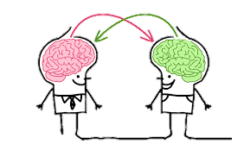
Why to use the humour as a teaching style?
As humans, our rational thinking and the learning processes cannot be disassociated of our emotions. Our level of attention in a class or in training is direct related with our feelings, so..
The use of humor can helps to create an empathy between the learners and educators, also creating a safer and more enjoyable learning environment and process. Not just for the learners, but for both directions. Why??

Slide 3
Because…
The perception of a teacher/trainer as a person, flexible, open to interact and to laugh more than a static “object” of depositing knowledge,
PLUS
the valorization of the learners as people with a lot of content to be shared and also taught can totally change and improve the quality of the human relations in an learning environment what will directly impact on the learning process by itself!

Slide 4
Introduction of the activity
The activity must be conducted after a group cohesion has been created; .
Can be done individually or in groups of 4 to 6 people; .
The trainer distributes the instructions step by step after the groups are formed.

Slide 5
1. The trainer announces a surprise trip for 5 days in unknown land! (the name of the destination is not indicated yet)
2. Travelers should prepare the trip in 10 minutes. They should not forget to take small gifts for their guests.
→ Unknown land: a country with another culture, cultural codes.
→ The composition of the bag is done in groups or individually. They have the right to consult each other;
→ For the preparation of the composition of the bag must should be taken in count the target audience and the thematic that each participants works in real life;
Example: The Local Mission invites ANI to come and remobilize 10 young under justice for 5 days.

Slide 6
2. All participants are asked to make a restitution by miming the preparation of the trip in front of the other members of the formation. 2.1. The audience must recognize the composition made by the ones that are presenting.
This part highlights the cultural, professional, gender codes ... everyone composes their suitcases upstream (tools, frameworks, skills) in a trip (training order) in an unknown territory (the trainer does not know the motivation of the people that they will train), so he/she prepares the trip/the training according to its codes.
- Important to pass the message that the people that we will meet doesn’t have the same codes than us!

Slide 7
After 10 hours flying……

Slide 8
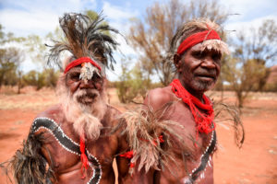
The plane lands at the aborigines in Australia.
The landing moment highlights the change of the contexts.
( The preparation made before will not be necessarily useful)
3. The group must play (dramatize) the encounter with this people who is invisible (and doesn’t speak the same language)
3.1. The participants can open their luggage or can create another one!
( This part requires to review the codes to meet different people, with different backgrounds and motivations. When teaching with humor, we are faced with learners with low opportunities, in a short time we need to find how to match their needs, so…..

Slide 9
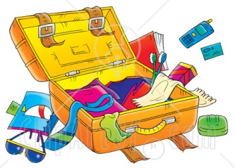
Should we open the suitcase??
Write it down what will you do.
4.1. How and what do you feel about it?

